Slide 1
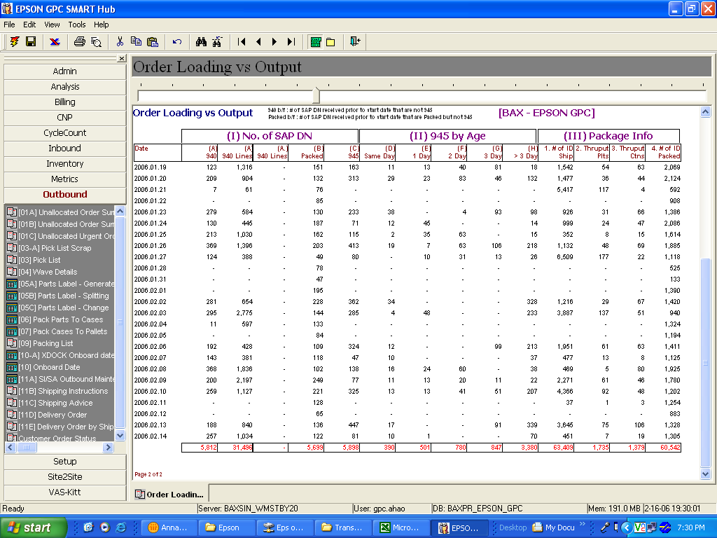
Add 1 column to show no. of lines packed per day

